Slide 1
Prototype
Grupo 43
Daniel Felipe Ortiz, Cesar Avellaneda, Javier Barrera, Julián Rolón, María Paula Estupiñán y Daniel Fuentes

Slide 2
Problem and solution

Slide 3
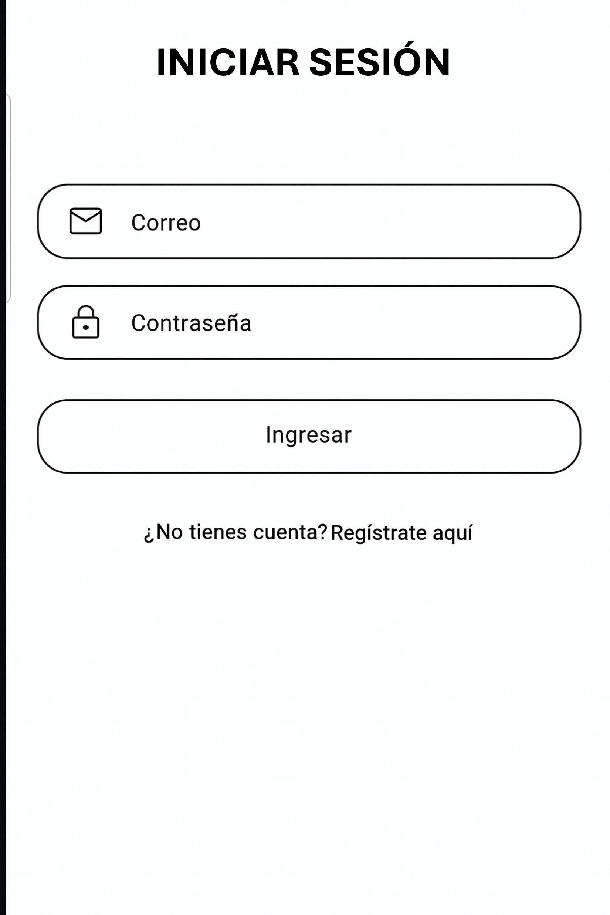
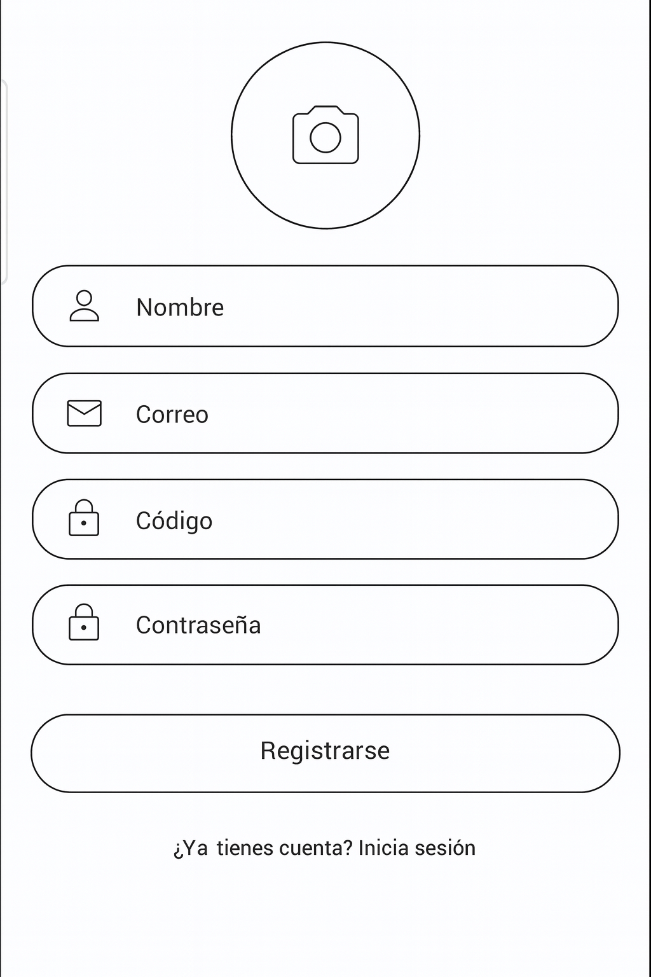
LOGIN AND REGISTRATION

Slide 4
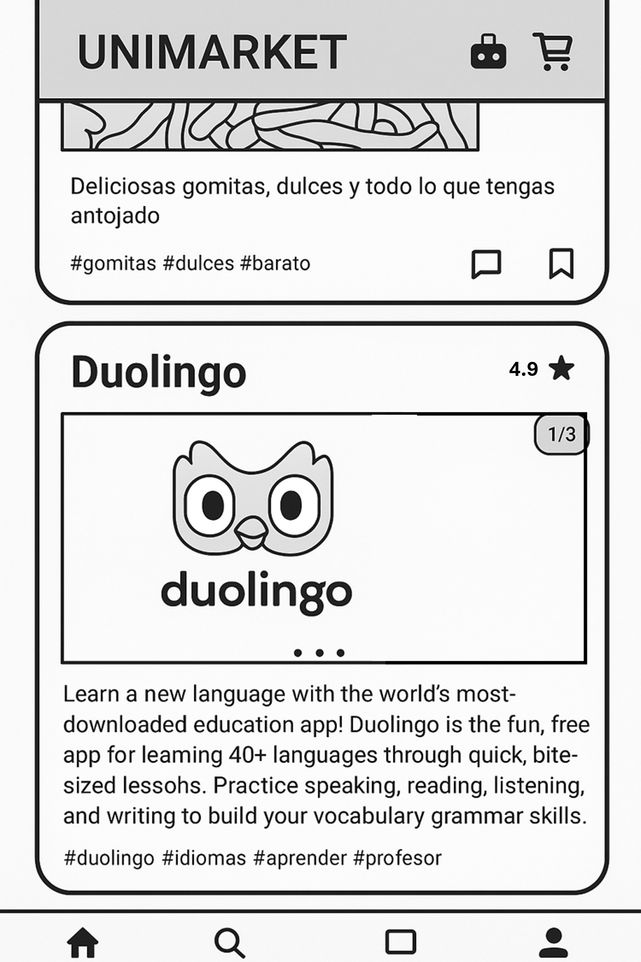
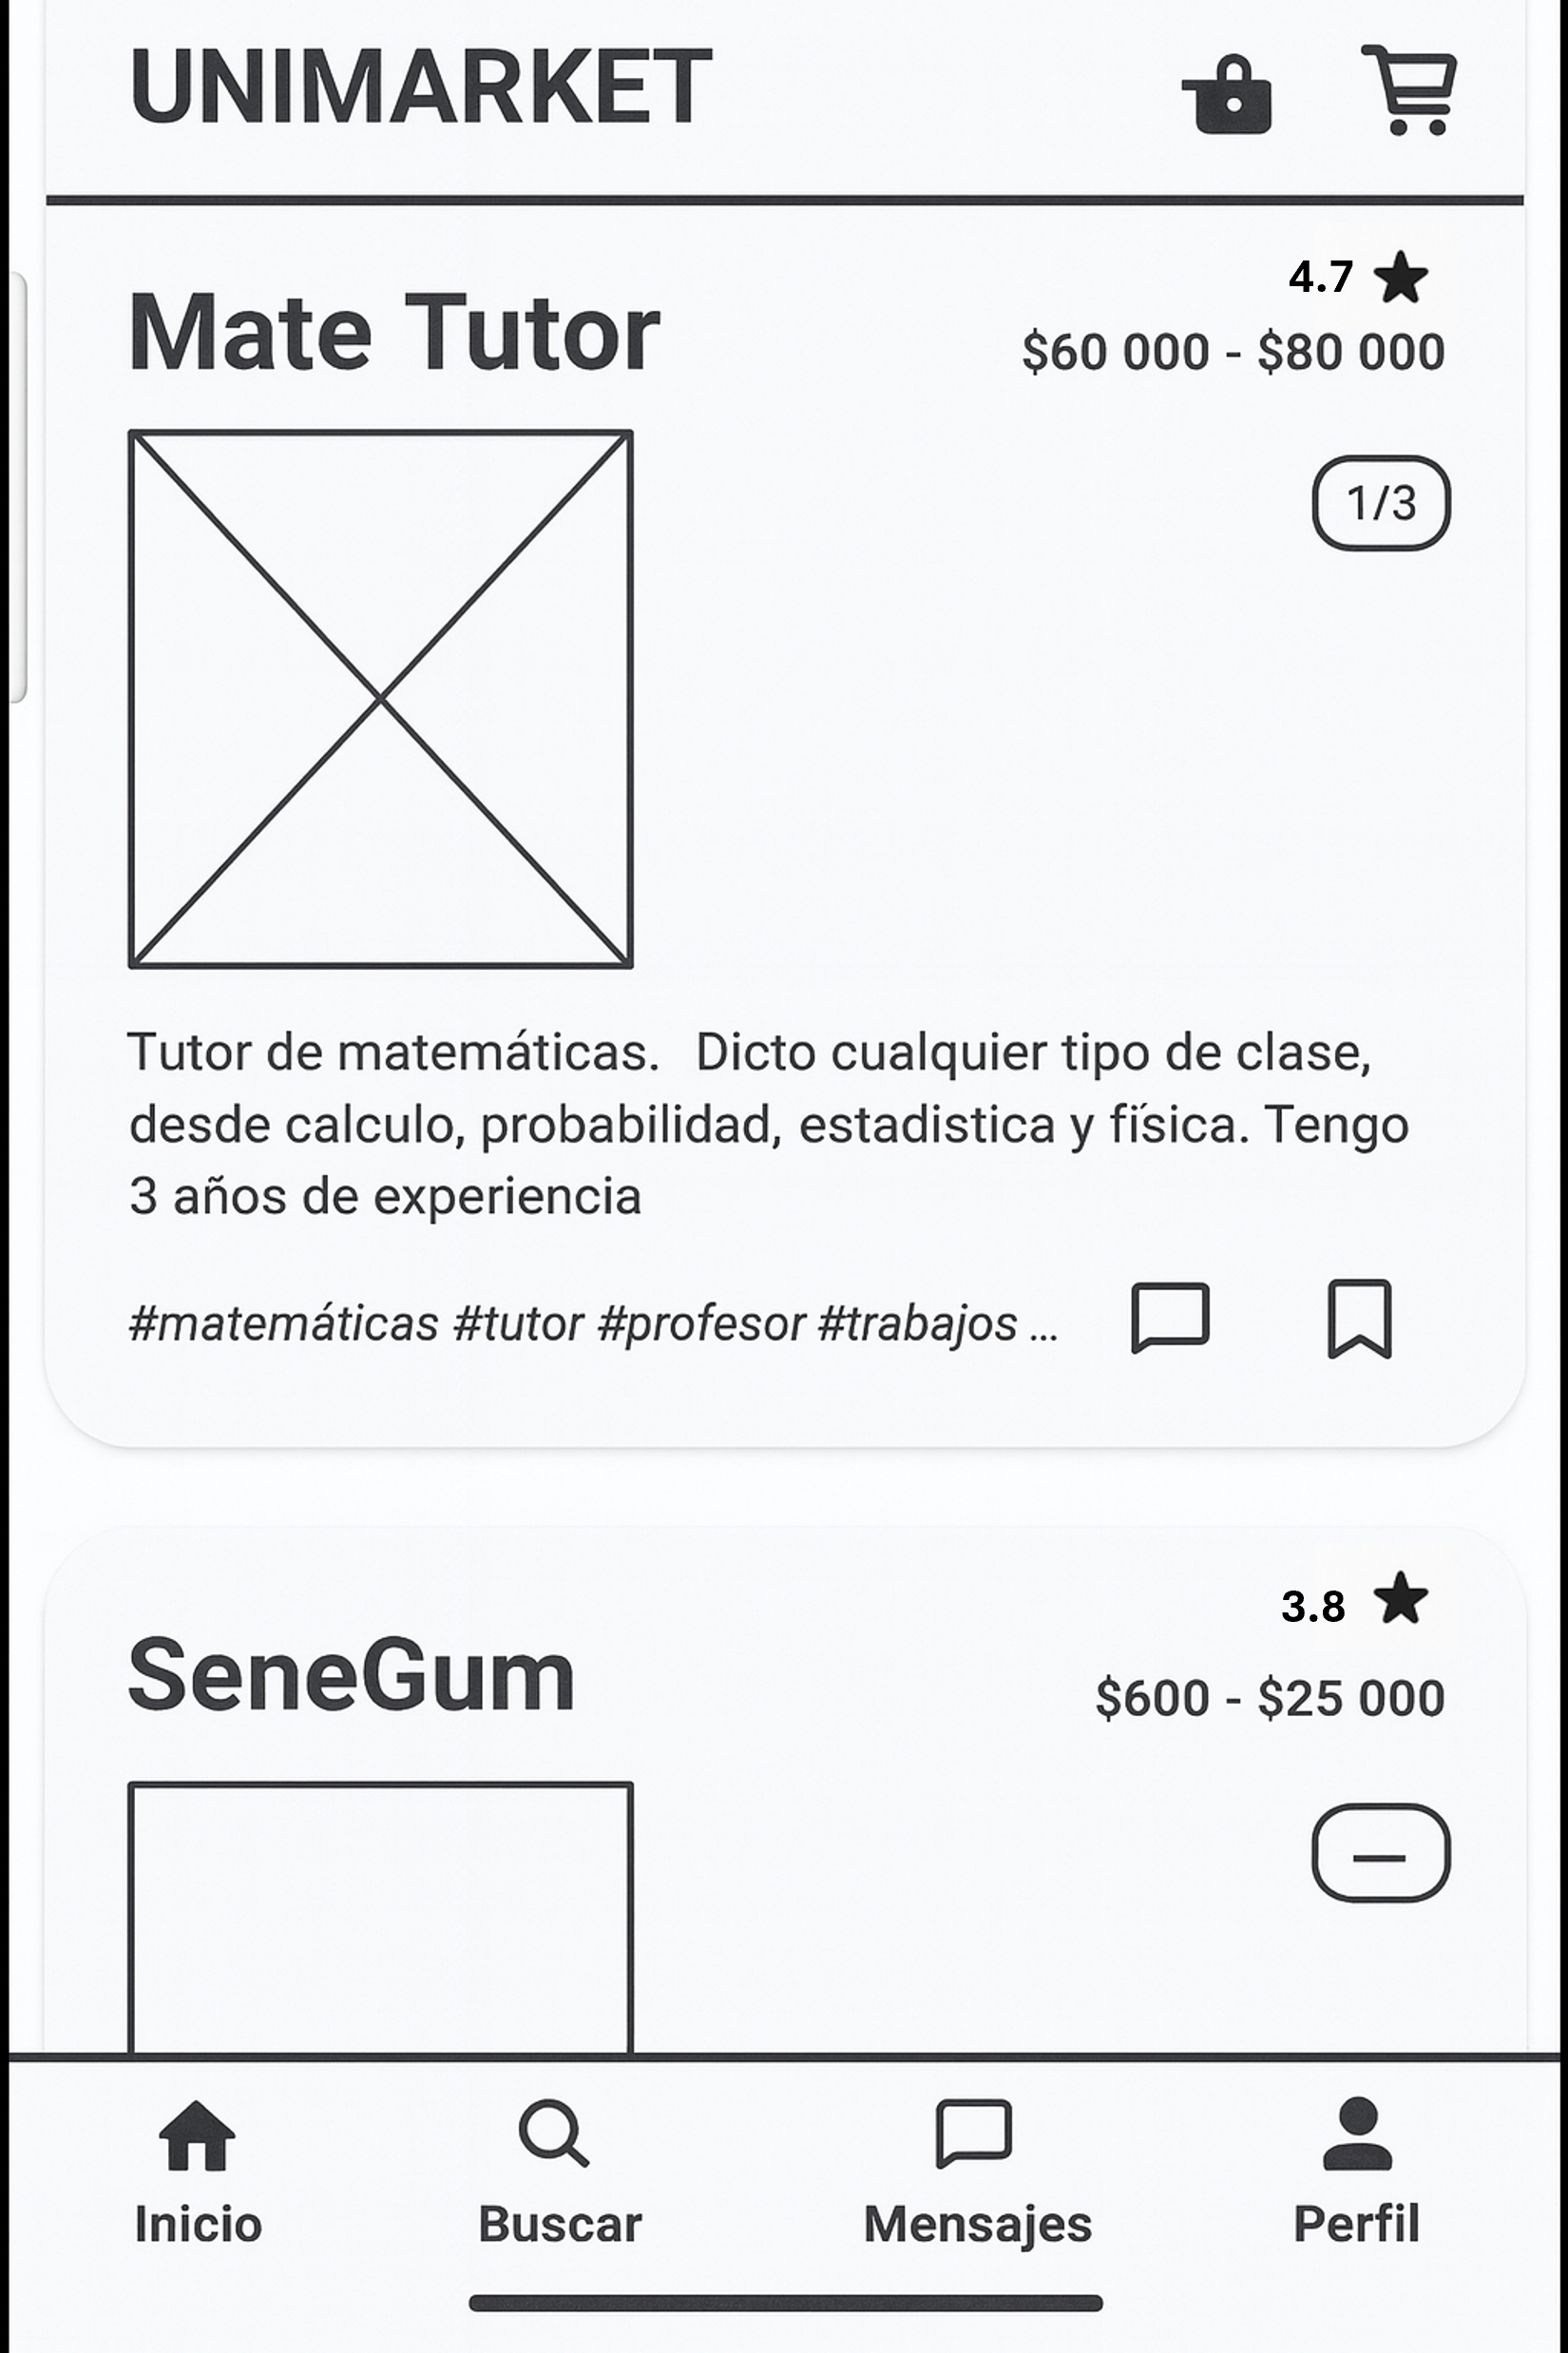

homepage

Slide 5
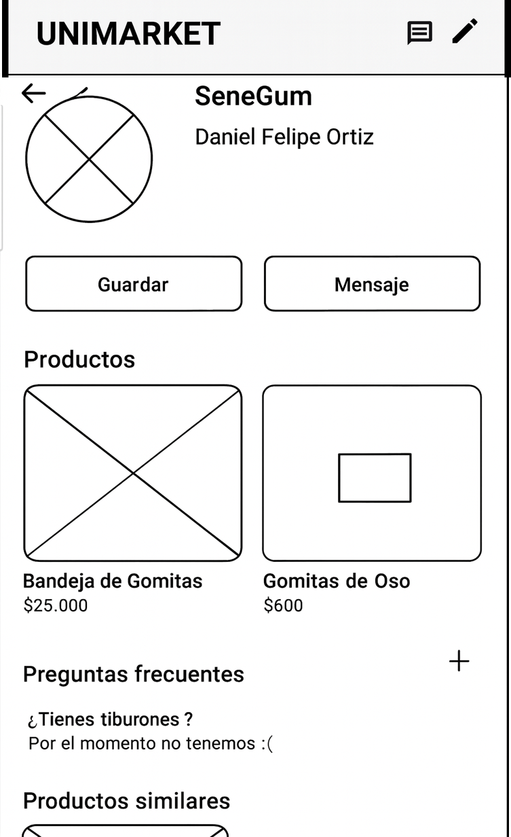
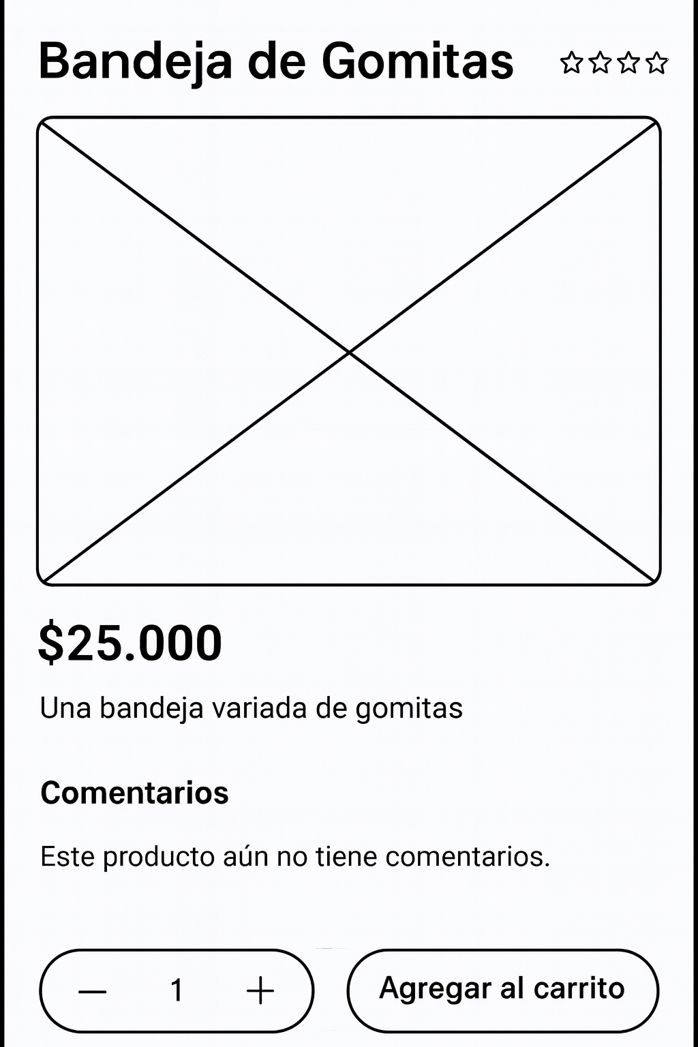
Products

Slide 6
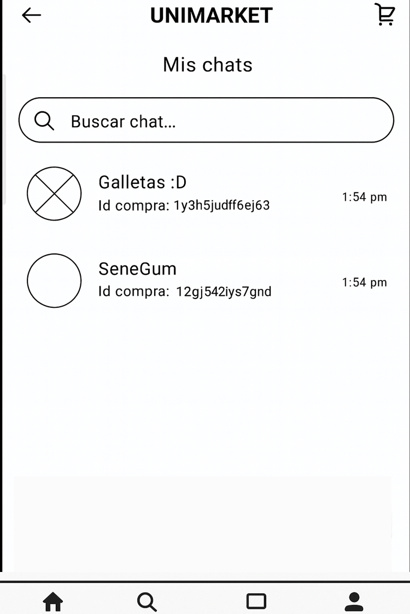
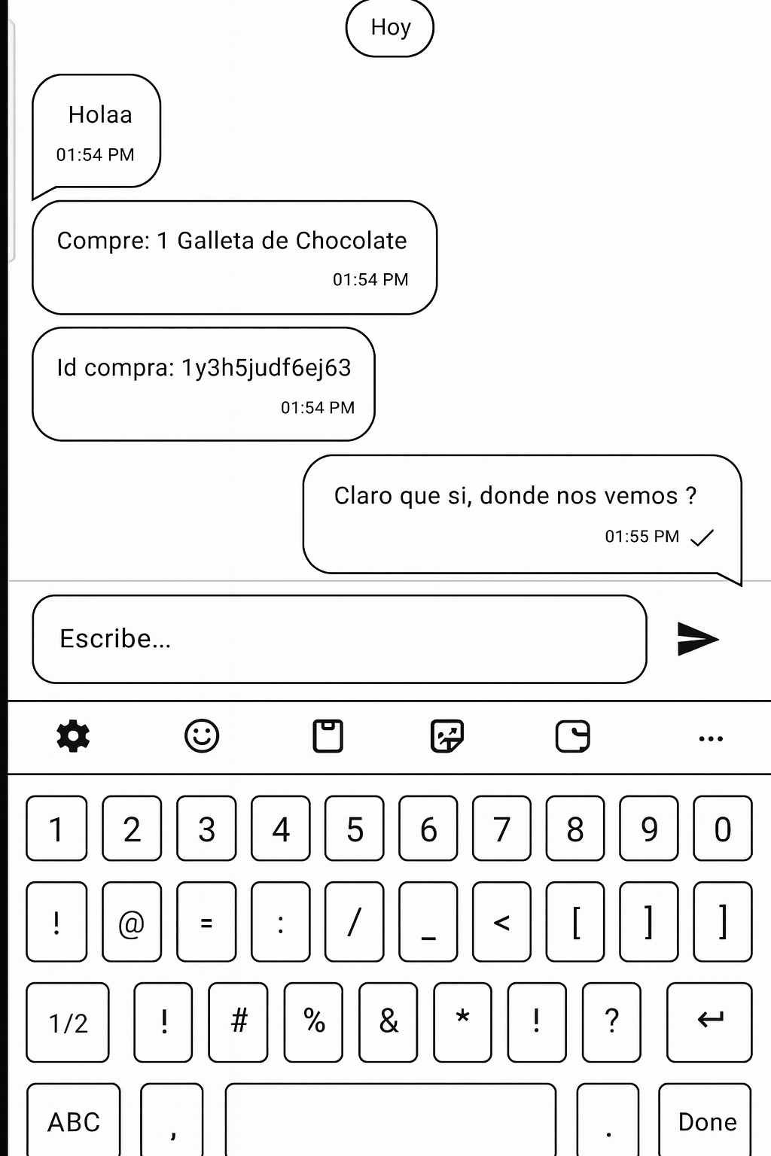
chats

Slide 7
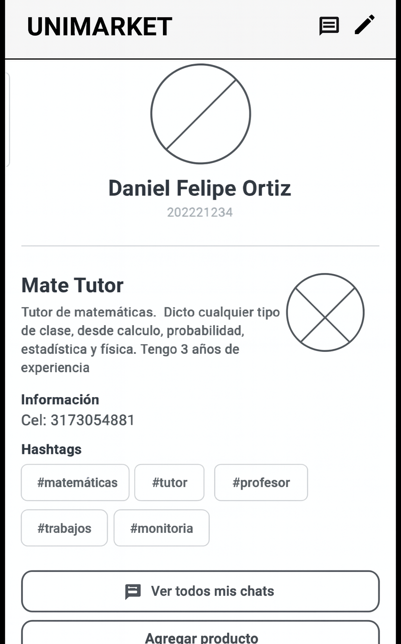
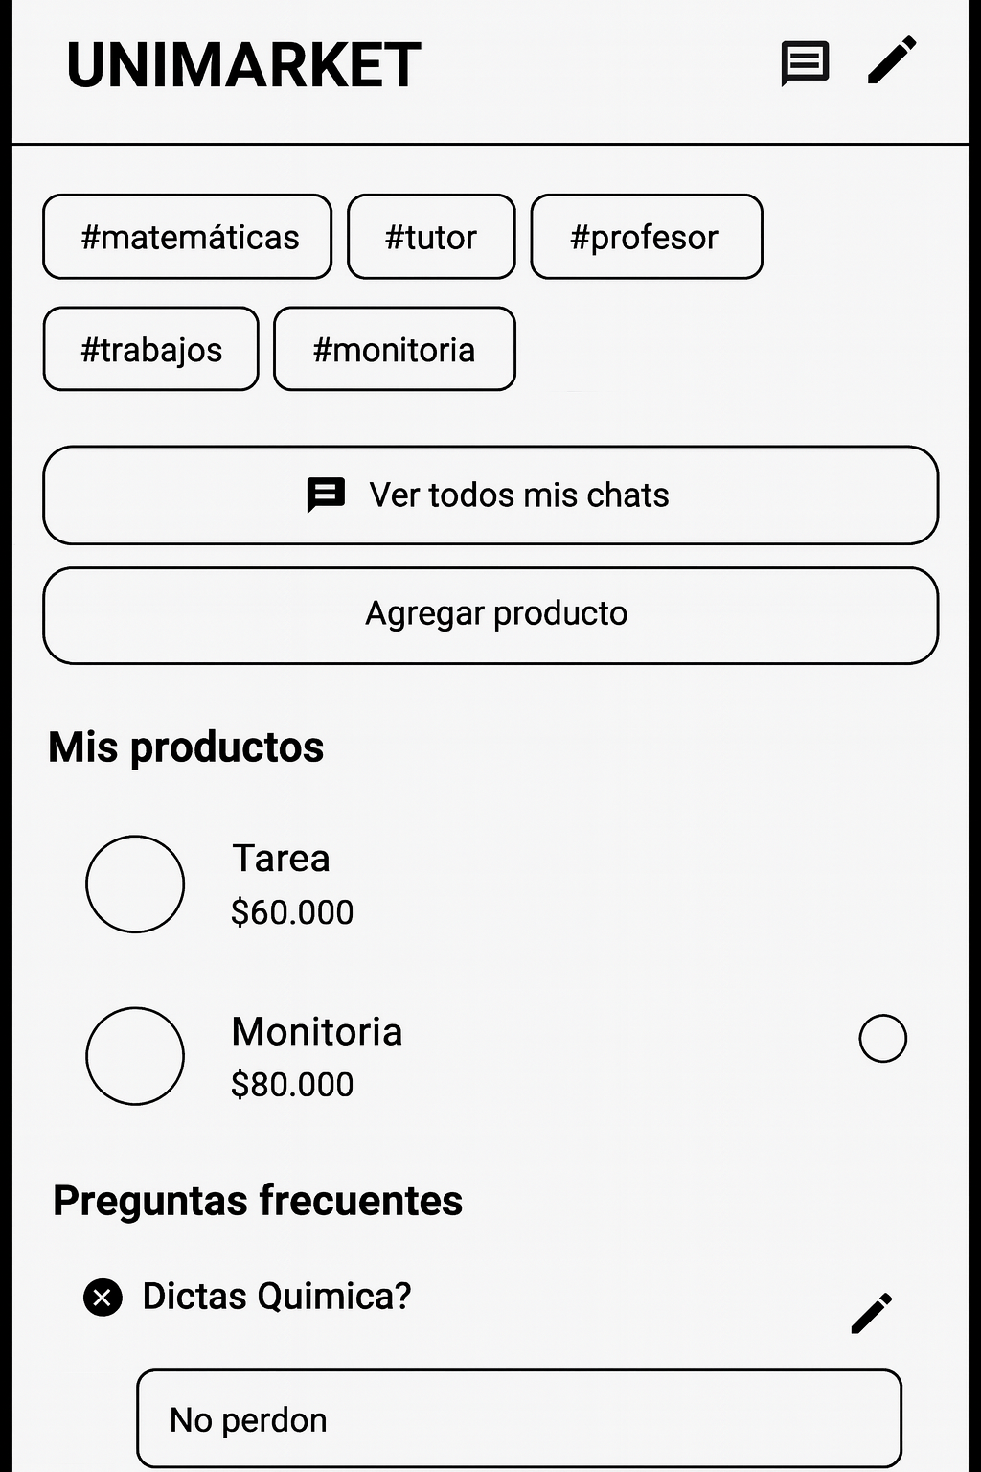
Profile

Slide 8
THANKSSS

